Slide 1
HackOrbit 2025
CODEKSHATRIYA

Slide 2

THEME & PROBLEM STATEMENT
Theme :
Integrated and Personalized Holistic Healthcare for All
Problem Statement :
In the age of digital overload, self-care has become confusing, inconsistent, and often inaccessible. Individuals—especially women
—struggle to find a single, reliable platform that supports physical health, mental wellness, and feminine care in a personalized and culturally relevant way. Existing solutions are either too generic or scattered across multiple apps, leaving users without the holistic support they need for effective daily self-care.

Slide 3

PROPOSED SOLUTION
CareHub is a smart, all-in-one platform for personalized self-care, offering:
AI-driven diet planning based on preferences and region
Emotional wellness chatbots for mental support
Guided fitness plans tailored to individual goals
Feminine health tools through Her Care
One seamless platform for holistic wellness
CareHub makes health simple, personal, and accessible — anytime, anywhere.

Slide 4
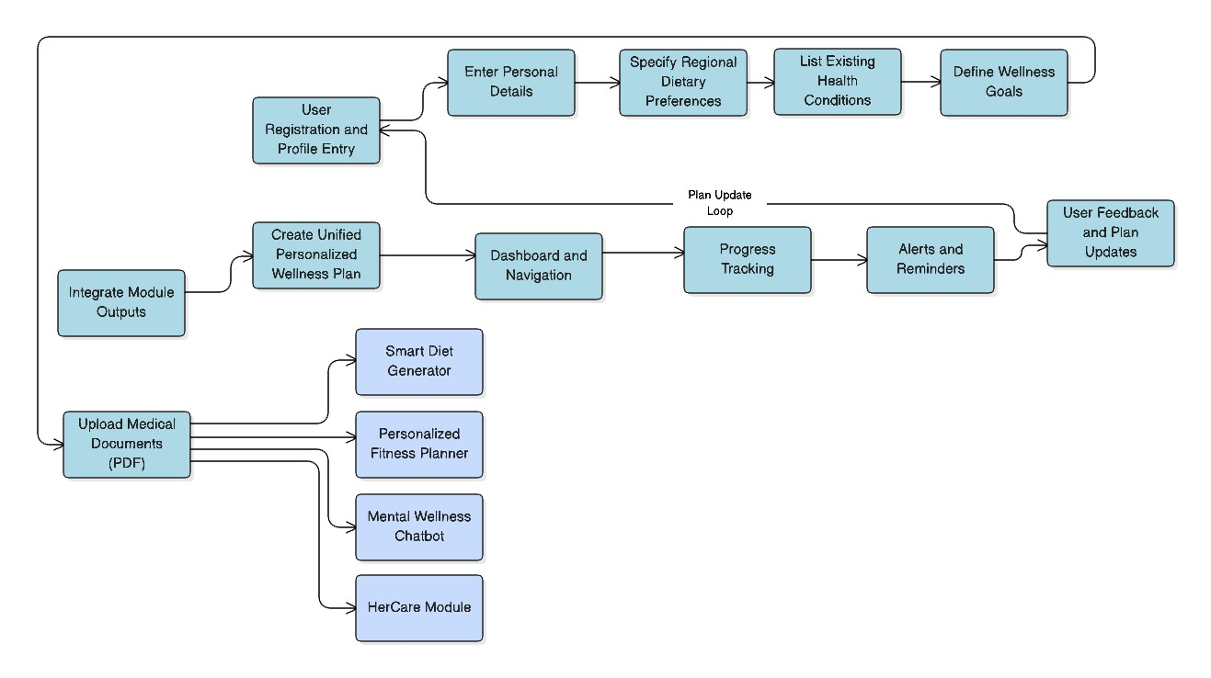
FLOWCHART

Slide 5

FLOWCHART EXPLANATION
User Onboarding & Profile Setup
Users begin by registering and entering personal information, regional dietary preferences, existing health conditions, and wellness goals. This forms the foundation for personalized planning.
Medical Document Upload
Users can upload health records (PDFs), enabling deeper insights and improved accuracy in generating wellness recommendations.
Modular Wellness Engine
Key modules like the Smart Diet Generator, Personalized Fitness Planner, Mental Wellness Chatbot, and HerCare Module work together to create targeted support.
Unified Personalized Wellness Plan
Outputs from all modules are combined into a single, coherent wellness plan tailored to individual needs and lifestyle.
Interactive Dashboard
A centralized, mobile-friendly interface lets users view plans, navigate features, and manage their health journey effortlessly.
Progress Tracking & Monitoring
The system monitors user activity and health progress to ensure goals are being met and plans stay relevant.
Alerts and Reminders
Users receive timely notifications to keep them engaged and consistent with workouts, diet, and wellness practices.
Continuous Feedback Loop
User feedback and ongoing health data help update and refine the wellness plan, making it adaptive over time.

Slide 6
FEATURES AND NOVELTY
AI-Powered Personalized Wellness
Delivering tailored health and lifestyle recommendations based on comprehensive user data.
Integrated Holistic Care
Seamlessly combining physical fitness, mental wellbeing, and feminine health into one unified platform.
Smart Diet Recommendations
Leveraging user inputs and document analysis (PDFs) to create customized, goal-oriented meal plans.
In-App Mental Wellness Chatbot
Providing immediate, empathetic support for emotional health anytime, anywhere.
Custom Fitness Guidance
Personalized workout plans designed around individual health goals and conditions.
All-in-One Intuitive Experience
A mobile-friendly, easy-to-navigate platform that empowers users to manage their holistic wellness effortlessly.

Slide 7


DRAWBACK AND SHOWSTOPPERS
Drawbacks:
Data Dependency: Personalized advice depends on accurate, complete user input.
Limited Medical Validation: AI predictions don’t replace professional diagnosis or emergency care.
Static Fitness Content: Fitness guides aren’t yet fully personalized by health conditions.
AI Limits: Chatbots may struggle with rare or complex cases outside their training data.
Showstoppers:
Privacy & Security: Compliance with laws like HIPAA/GDPR is critical; breaches could block deployment.
AI Risks: Incorrect AI advice poses safety and ethical concerns, needing clear disclaimers.
Integration Hurdles: Accessing medical records can be challenging due to inconsistent hospital systems.

Slide 8
CODEKSHATRIYA
ADITHYA HARSHITH REDDY - 7815805576 SHAIK ASHARAF - 9177973166
DONTHA NAVYA SRI - 6303392475 PAKALA NEHA - 9553455522

Slide 9

Thank you

